Slide 1
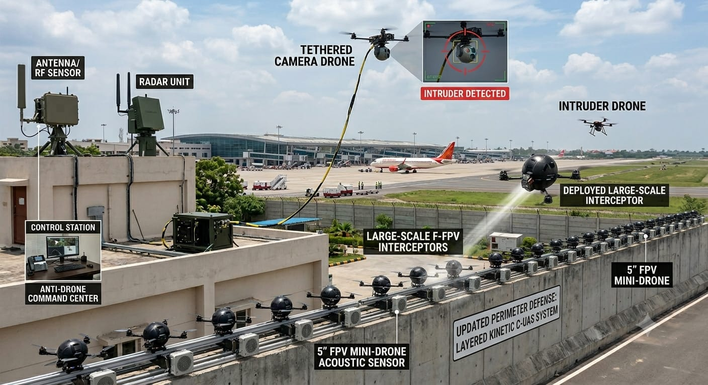
SENTINEL-DOME
COUNTER-UAS DEFENCE SHIELD
Rooftop-Integrated Autonomous
Protection for Critical Infrastructure
▸ AESA Radar
▸ EO/IR Cameras
▸ RF Detection
▸ Tethered ISR
▸ Kinetic Kill
PROTECTED SECTORS
Airports
Oil & Gas
Power Plants
Nuclear
Govt Buildings
Conceptual Design Document | For Planning & Discussion Purposes

Slide 2





EXECUTIVE OVERVIEW
A self-contained sensor-to-shooter loop for critical infrastructure protection
SENTINEL-DOME is a roof-mounted, perimeter-integrated Counter-UAS system that detects, classifies, and neutralizes hostile drones threatening critical infrastructure. The same architecture protects airports, oil & gas terminals, thermal/nuclear power plants, and high-value buildings — combining persistent surveillance with a layered hard-kill response across a 5 km protective premise.
360° AESA Radar
EO1/EO2 Day-Night Cam
RF Spectrum Detector
Electronically-steered array tracks multiple low/slow/small drones, generating RCS data for threat sizing.
Dual EO/IR turrets confirm shape, payload, and behaviour of every cued contact, day or night.
Passive detector picks up control-link emissions for early warning and direction-finding.
Tethered ISR Drone
Boundary Interceptors
Rooftop-anchored drone rises during wartime alert for elevated, persistent watch over 5 km.
Ball-shaped tethered interceptors neutralize threats by kinetic collision or payload detonation on impact.
Conceptual Design Document | For Planning & Discussion Purposes

Slide 3
LAYERED KINETIC C-UAS SYSTEM
Updated perimeter defence — as deployed at airport installations
Conceptual Design Document | For Planning & Discussion Purposes

Slide 4



SYSTEM ARCHITECTURE
Rooftop sensor mast + boundary-wall interceptor network around the protected facility
🏢 ROOFTOP MAST
🛡 BOUNDARY-WALL INTERCEPTORS
AESA Radar
5" FPV Mini-Drones
Electronic steering, multi-target tracking, RCS signature data for threat classification.
Compact interceptors on rail launchers. Kinetic collision against micro-UAS at close range.
EO1 Turret — Primary
Large-Scale F-FPV Interceptors
Long-range day/night optical identification; auto-slew to radar cue.
Higher-mass interceptors for medium/large threats. On-rail launch with rapid deployment.
EO2 Turret — Secondary
Deployed Large-Scale Interceptor
Wide-area secondary sector coverage; stereo confirmation with EO1.
Pre-positioned elevated interceptor activated for immediate engagement of incoming threats.
RF Detector
Acoustic Sensors
360° passive control-link detection; frequency & protocol fingerprinting.
Array detects rotor noise signatures — supplements radar in GPS-denied environments.
Tethered ISR Drone
Anti-Drone Command Center
Wartime persistent elevated watch, 5 km radius; launched on AMBER alert.
Hardened control station with real-time threat display, operator override, engagement authority.
Conceptual Design Document | For Planning & Discussion Purposes

Slide 5
DETECTION, CLASSIFICATION & THREAT SCORING
Fused RCS, RF emission, and EO1/EO2 visual data classify every contact before interceptors are committed
RCS / RADAR
RF SPECTRUM
EO1 / EO2
TETHERED ISR
Size · Speed · Altitude · Trajectory
Control-link Frequency & Protocol
Visual Shape · Payload · Behaviour
Elevated Wide-Area Wartime Watch
⚡ SENSOR FUSION ENGINE
THREAT
RCS / RADAR INDICATORS
EO1/EO2 VISUAL
INTERCEPTOR RESPONSE
MODE
LOW
Small RCS, slow speed, transiting (not approaching facility)
No visible payload; recognized commercial silhouette
Monitor only — interceptors remain armed/standby
STANDBY
MEDIUM
Moderate RCS, direct approach vector, loitering near boundary
Camera/sensor pod visible; flight path consistent with recon
Launch interceptor — collision mode, no payload detonation
COLLISION
HIGH
Large RCS, high-speed attack profile, swarm indicators
Visible slung payload; aggressive descent toward target
Launch armed interceptor — payload detonation on impact
DETONATE
Conceptual Design Document | For Planning & Discussion Purposes

Slide 6
ENGAGEMENT SEQUENCE — KILL CHAIN
Automatic detection-to-neutralization sequence, with operator override at every stage
01
DETECT
02
CLASSIFY
AESA Radar + RF Detector achieve first detection. Track initiated. Tethered ISR drone launches on AMBER alert.
Sensor fusion engine scores threat using RCS, RF fingerprint, and EO1/EO2 visual confirmation.
03
AUTHORISE
04
INTERCEPT
AI-assisted threat scoring presented to operator. Engagement authority confirmed (auto or manual override).
Appropriate interceptor selected. FPV mini-drone or Large-Scale F-FPV launched from boundary wall.
05
NEUTRALISE
06
REPORT
Collision mode (Medium): kinetic ram disables rotors. Payload mode (High): detonation on impact.
Event logged. Forensics capture from EO cameras. C2 alert dispatched. Interceptors rearmed and reset.
⚠ Operator retains override authority at every stage. Autonomous engagement only in pre-authorised zones.
Conceptual Design Document | For Planning & Discussion Purposes

Slide 7
COVERAGE ZONES & DEPLOYMENT SCENARIOS
Three concentric coverage rings scaled to the 5 km protective premise
Ring 1: AESA Radar / RF Detection
✈ Airports
Ring 2: EO/IR Visual Confirmation + ISR Drone
Rooftop mast on ATC tower or terminal. Tethered drone activated in heightened security states.
Ring 3: Boundary-Wall Interceptor Engagement Zone
🛢 Oil & Gas Terminals
Masts on tank-farm control buildings. Detonation geometry planned away from flammable zones.
⚡ Thermal Power Plants
500m
2 km
5 km
RF array tuned for high-EMI environments. Redundant AESA coverage across switchyards.
☢ Nuclear Facilities
Overlapping multi-mast radar. Collision-mode prioritized near containment zones.
🏛 Govt / Commercial Buildings
Compact single-mast config. Interceptor pods integrated into existing perimeter wall.
Conceptual Design Document | For Planning & Discussion Purposes

Slide 8
KEY METRICS & CAPABILITIES
Sensor-to-shooter, self-contained, scalable from single building to campus-wide protection
5 km
360°
3
Protective Premise Radius
AESA Radar Coverage
Layered Coverage Rings
2
5
<2s
Interceptor Modes
Critical Sectors Protected
Detection-to-Track Time
Same architecture scales from a single rooftop installation protecting a building to a multi-mast network securing an entire airport, refinery, or power generation complex within a 5 km protective premise.
Conceptual Design Document | For Planning & Discussion Purposes

Slide 9
SENTINEL-DOME
COUNTER-UAS DEFENCE SHIELD
NEXT STEPS
1. Site survey and threat environment assessment
2. Facility-specific coverage mapping and mast-placement study
3. Interceptor grid density calculation vs perimeter length
4. Regulatory clearance: civil aviation and RF emission approvals
5. Pilot installation and live-trial engagement exercise
Conceptual Design Document | For Planning & Discussion Purposes

